Slide 2
Portal of Palacký University
STAG

Slide 3
CONTENTS
What is Portal of Palacký University & STAG?
What are their functions
How to login to Portal STAG
To Enrol in a course

Slide 4
PORTAL is a platform where you get all necessary information about your study, students, courses, lecturers, schedule of courses, UP canteen…
STAG is an application of PORTAL for study affairs, students, academic and administrative staff
STAG – STudy AGenda of Palacký University

Slide 5
Portal STAG has a public and nonpublic part. Nonpublic part requires login.
If you want to enrol in a course, to find more details about a course or for example to order your food in UP canteen, you have to login to Portal (nonpublic part of Portal).
1st step: find the page of Portal on http://portal.upol.cz/
2nd step: click on ENGLISH FLAG

Slide 6
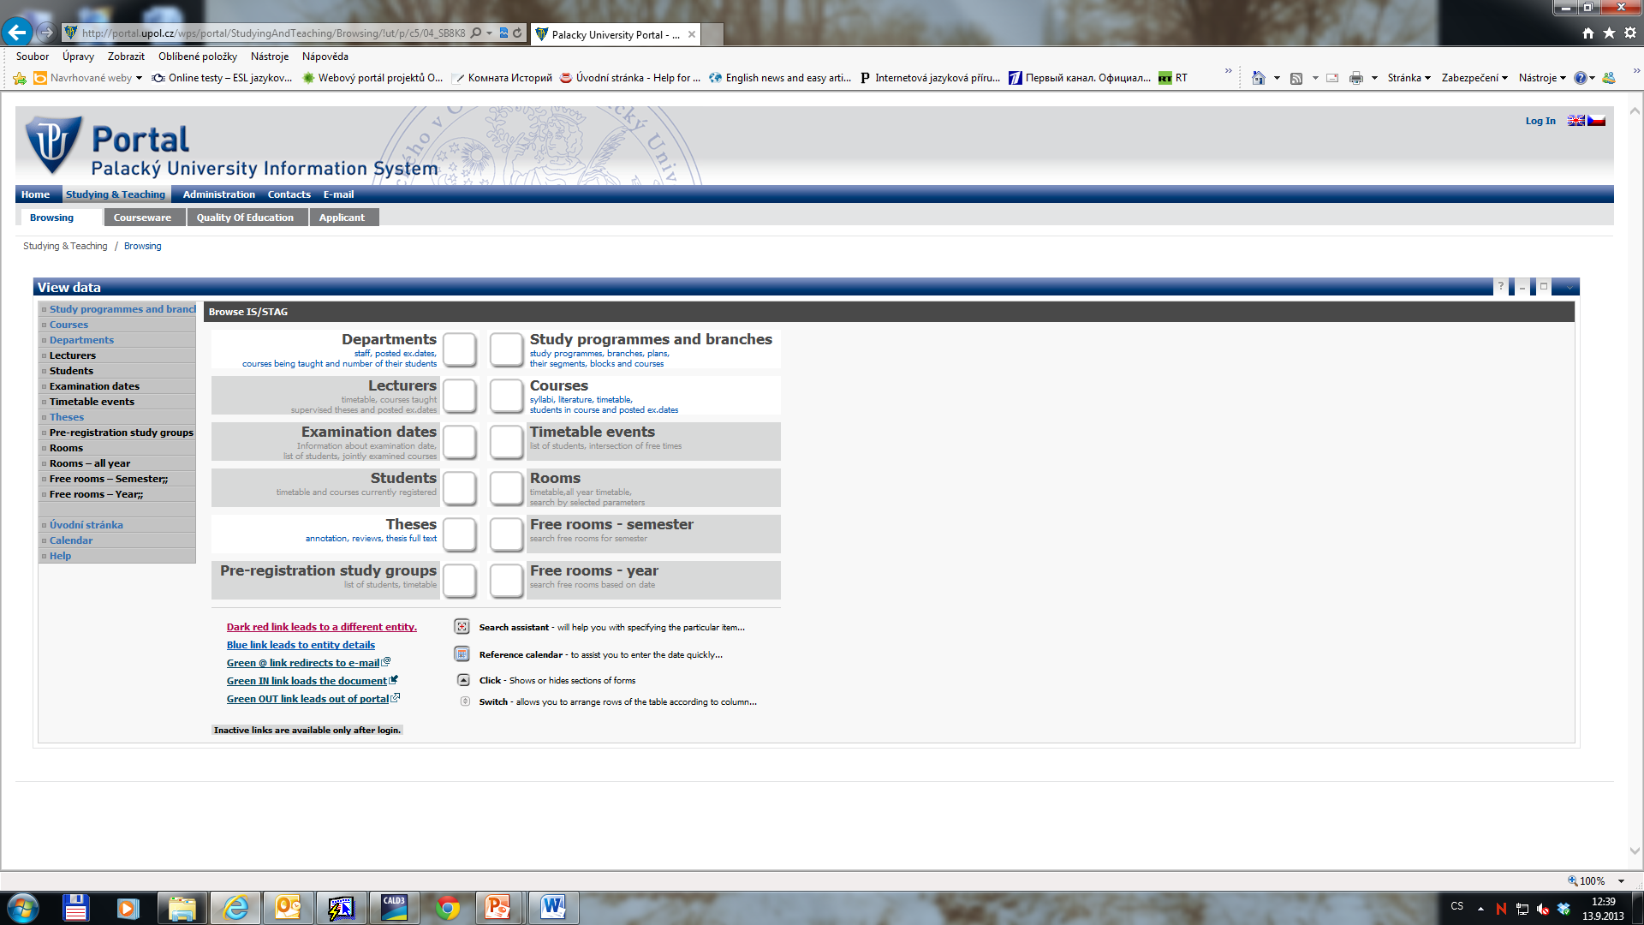
STAG WITHOUT LOGIN TO PORTAL
Only some general information

Slide 7
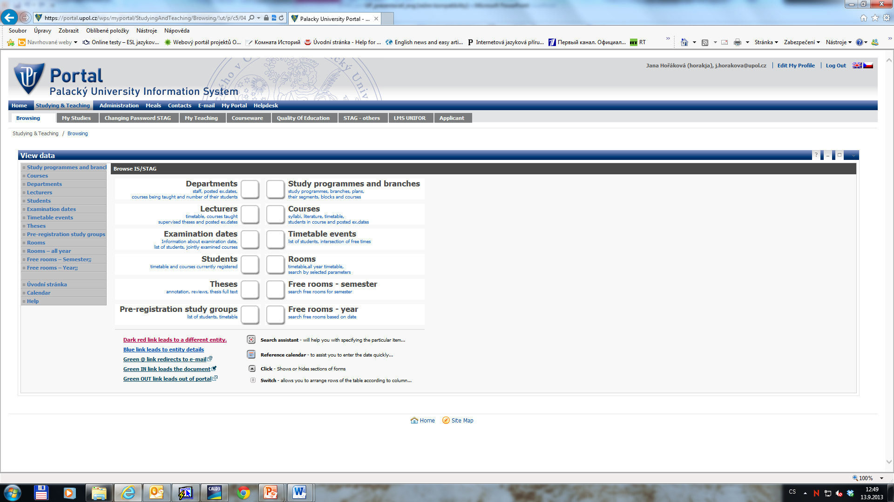
STAG AFTER LOGIN TO PORTAL
Portal STAG with more functions and details
To access the STAG you will need your username and your password

Slide 8
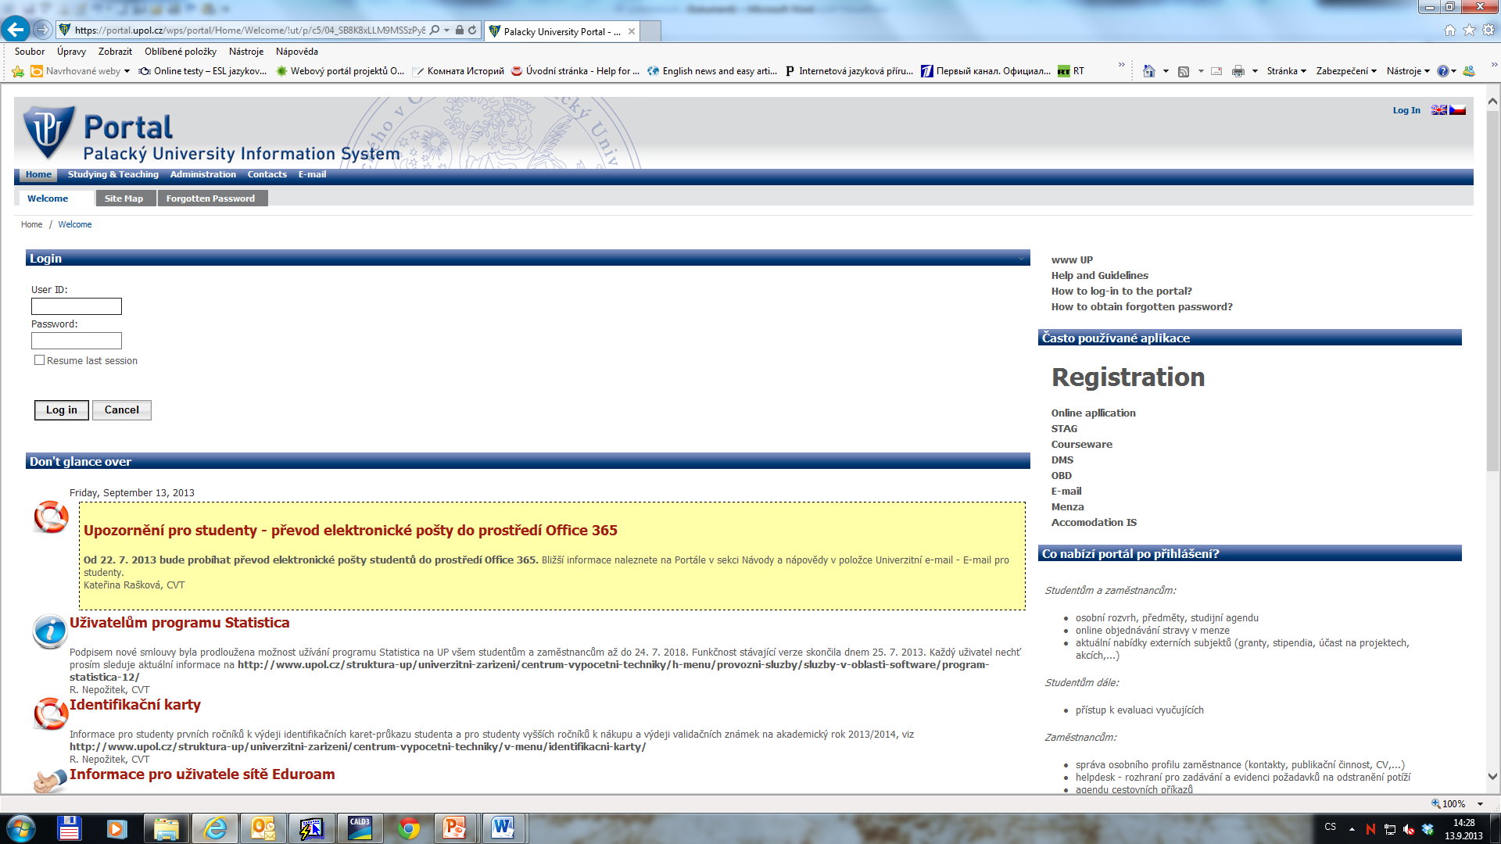
LOG IN TO PORTAL
LOG IN
1. Enter your ID (Portal ID)
2. Enter your Password → your Identification Nr./birth code

Slide 9
HOW TO FIND YOUR ID NUMBER
Portal ID Number – go to http://portal.upol.cz/ → Contacts type your family name into the first field of the part „Upol Hledání studentů“, and click search.
In this way you will get your ID Number (see the example on the next page)

Slide 10
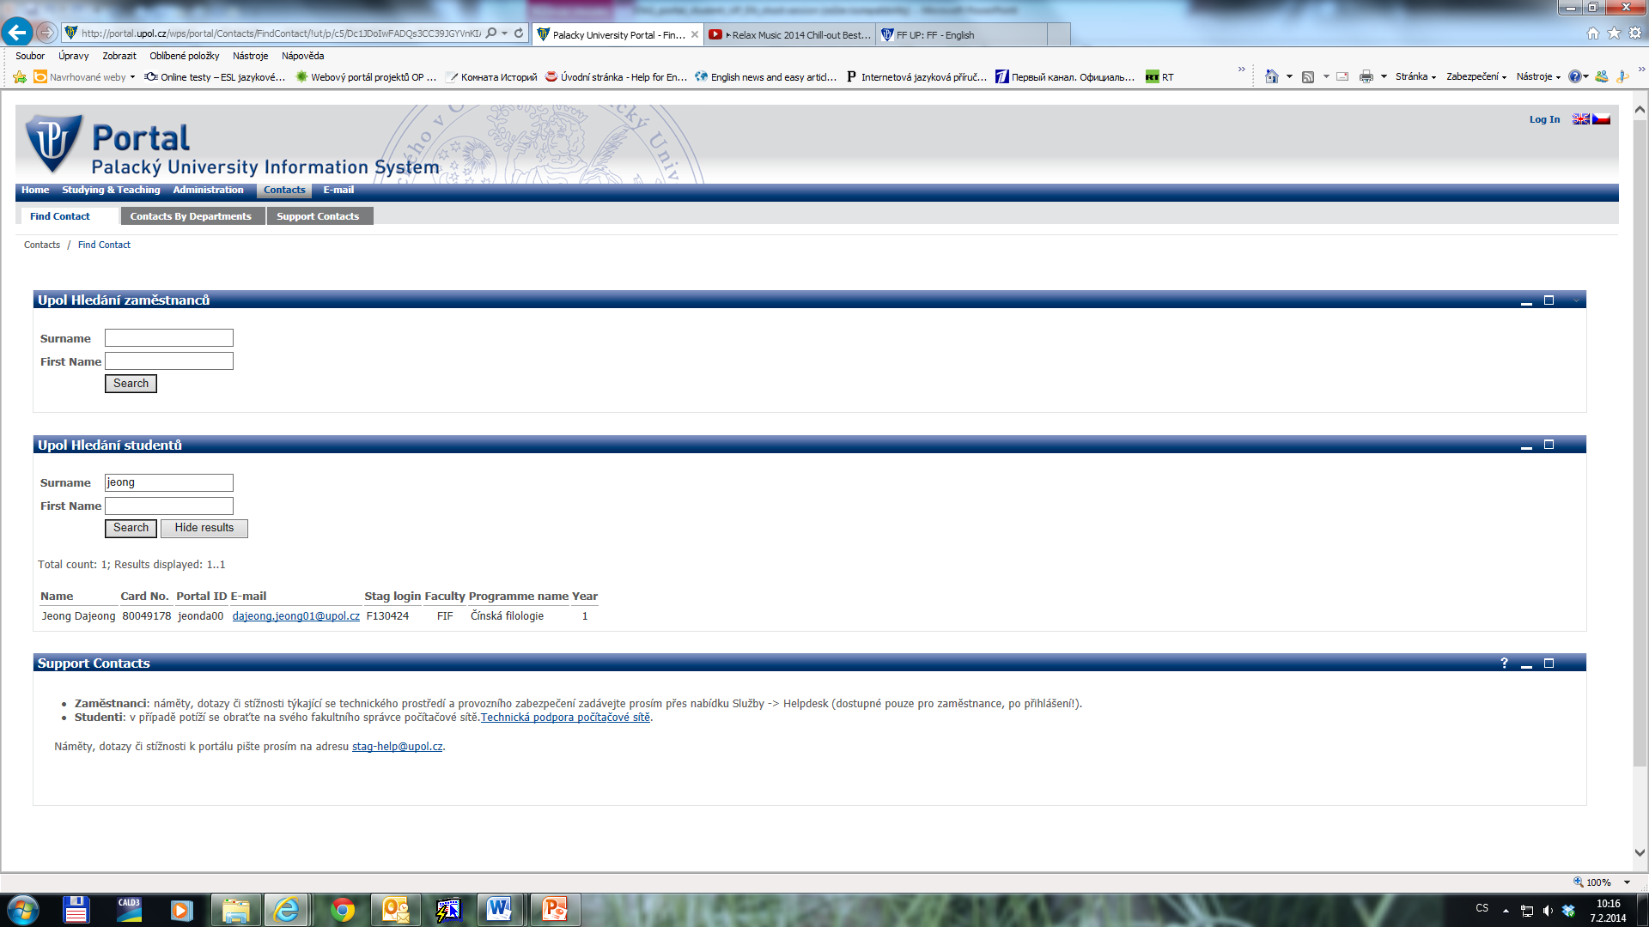

Slide 11
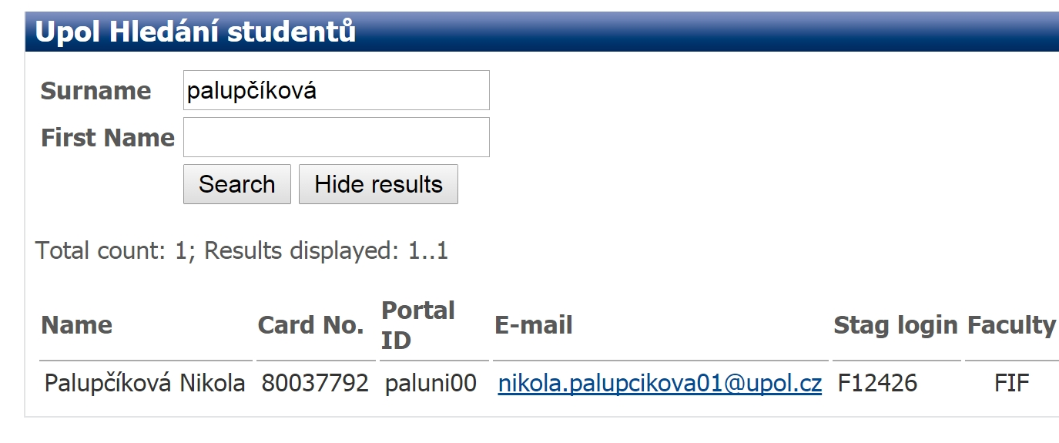
Your Portal ID No.

Slide 12
HOW TO LOG IN - PASSWORD
Password – a code which you received during the on-line registration before you came to Olomouc.
In case you forgot the code, ask Mrs. Hamdanieh or your Faculty coordinator in the international office.

Slide 13
WHERE TO FIND THE COURSE CODE
WEB PAGE OF A DEPARTMET AT UP
Check the web page of your „home“ department at UP
PORTAL UP
http://portal.upol.cz/ (English version) → Courses. Then you need the abbreviation/the code of your or any other UP department to have an overview of the courses. For courses taught in English, choose English language.
WEB PAGE OF UP
Go on http://www.upol.cz/en/ → Studying → Course Catalogue
International students can choose courses of all departments and of all faculties!

Slide 14
HOW TO ENROL IN THE COURSE
You can enrol online by yourselves if there is a free place in the course before the semester starts
If there is no free place (full capacity in the course) you can´t enrol by yourself immediately, but you can ask the teacher of the course after the first lesson to permit you to attend the course (she/he approves this by signature on your enrolment form).
In both cases above (free course, full course) ↑ you need to fill out ALL your courses you have chosen in the EXCHANGE STUDENT ENROLMENT FORM (EF) and give a copy to your faculty coordinator (see the names and contacts in your Enrolment form) till the end of February 2015. The faculty coordinator will register you also in these full courses.

Slide 15
BEFORE YOU LIVE HOME
After completing the course requirements, the lecturer should fill in your grade (or „passed/failed“) and provide signature not only into the STAG, but also into the Enrolment Form (for control).
The student must submit the EF to the responsible person (faculty coordinator – see the attached list of coordinators) to be able to made Transcript of Records.
Faculty coordinator will send the TofR to the student’s home institution and to the student's address as noted in the EF form only after all commitments between the student and UP (including Dormitories administration) have been settled up → it might take up to 5 - 6 weeks.

Slide 16
CONTACTS - OFFICE FOR INTERNATIONAL RELATIONS (RECTOR´S OFFICE OF PU)
FUNCTION/POSITION | NAME | CONTACT | AGENDA
Institutional Coordinator and Head of the International Relations Office | Mrs. Yvona Vyhnánková | yvona.vyhnankova@upol.cz | bilateral agreements learning agreements – LA (when previously signed by a UP departmental coordinator)
Coordinator for incoming Erasmus students | Mrs. Zuzana Hamdanieh | zuzana.hamdanieh@upol.cz | information for students interested in an Erasmus study stay at UP receives and administrates application materials, Learning Agreements sends letters of acceptance, practical information before arrival organization of the orientation week for incoming students Confirmation of study period
Coordinator for incoming non-EU students | Ms. Štěpánka Bublíková | stepanka.bublikova@upol.cz | information for students interested in an Erasmus study stay at UP receives and administrates application materials, Learning Agreements (non- Erasmus) sends letters of acceptance, practical information before arrival organization of the orientation week for incoming students Confirmation of study period

Slide 17
CONTACTS - DEPARTMENTS OF FOREIGN AFFAIRS AT PU FACULTIES
FACULTY | NAME | CONTACT
Faculty of Theology | Mrs. Kateřina Hamplová | Katerina.hamplova@upol.cz
Faculty of Medicine&Dentistry | Mrs. Zuzana Kullová | zuzana.kullova@upol.cz
 | Mrs. Jana Osmani | jana.osmani@upol.cz
Faculty of Arts | Mrs. Dana Sztwiertnia Hellová | dana.hellova@upol.cz
Faculty of Science | Mrs. Dana Gronychová | dana.gronychova@upol.cz
Faculty of Education | Mrs. Jana Dostálová | Jana.dostalova@upol.cz
Faculty of Physical Culture | Mrs. Zuzana Hanelová | zuzana.hanelova@upol.cz
Faculty of Law | Mrs. Radana Kuncová | radana.kuncova@upol.cz
Faculty of Health Sciences | Mrs. Irena Jedličková | irena.jedlickova@upol.cz

Slide 18
WHO ELSE CAN HELP ME
Your buddy
Your buddy
Your buddy

